Slide 1

Tsunami Warning System
These instruments are called DART buoys, which stands for “Deep-ocean Assessment and Reporting of Tsunamis.” The deep-sea gauges send information from a surface buoy through satellites to the warning centers..

Slide 2
Waves
1-Caused by wind, sun, and moon
2-Do not move water laterally
3-Transfer energy laterally
4-Water moves in vertical circles
5-Speeds of 5 - 60 mph
6-Wavelength of 300 - 600 ft

Slide 3
Tsunami Phenomenon
. A very long wave
. Caused by an underwater earthquake or underwater . volcanic eruption (epicenter)
. This disturbance has an incredible amount of force
. Energy dissipates away from the epicenter
. Speeds of 500 - 600 mph
. Wavelength of 60 – 300 miles

Slide 4
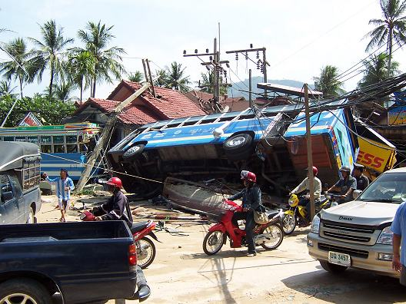
Tsunami Phenomenon Cont.
. As the wave approaches land,
it is pushed upward
. Principal region is Pacific Ocean
. Can occur in the Atlantic and Indian Ocean

Slide 5
December 2004 Tsunami
. Earthquake in Indian Ocean
. Rupture was ~1000 miles long
. Hit India, Thailand, Malaysia, Indonesia, many Islands, and Africa.
. Killed 200,000+ people
. Displaced 1.6 million people

Slide 6
NOAA and DART Stations
. NOAA - National Oceanic and Atmospheric Administrations
. Responsible for providing tsunami warnings to the Nation
. DART - Deep-ocean Assessment and Reporting of Tsunamis
. Station that detect tsunamis

Slide 7

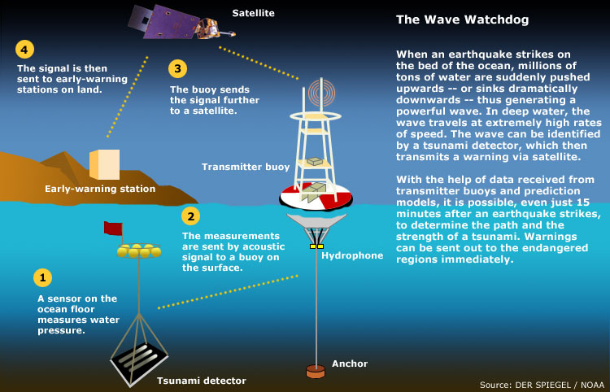
DART System

Slide 8
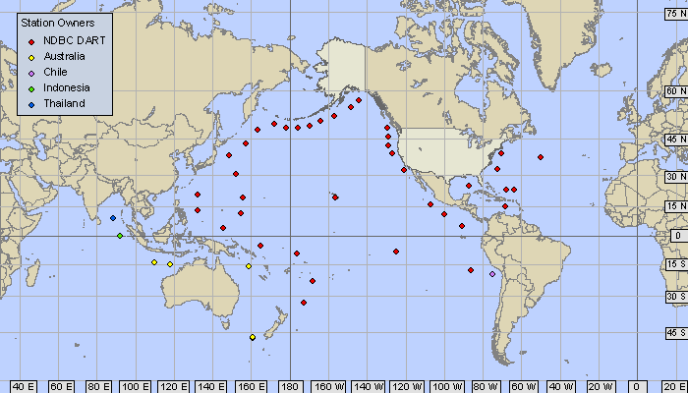
DART Program

Slide 9
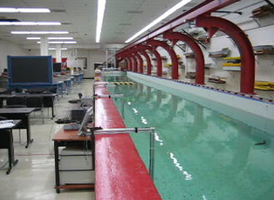
Objectives
.Build a system based off of the DART system that accurately detects the presence of a simulated tsunami
.Simulated tsunami is the longest wavelength wave that the Hydro Lab can create

Slide 10
Objectives Cont.
Communicate the presence of a tsunami to a communications hub on the surface
Explore the effect of turbulence on the force that arrives on shore
Use environmental sensors to possibly detect the oxygen level of the water, amount of marine life activity, or the pH of the water

Slide 11
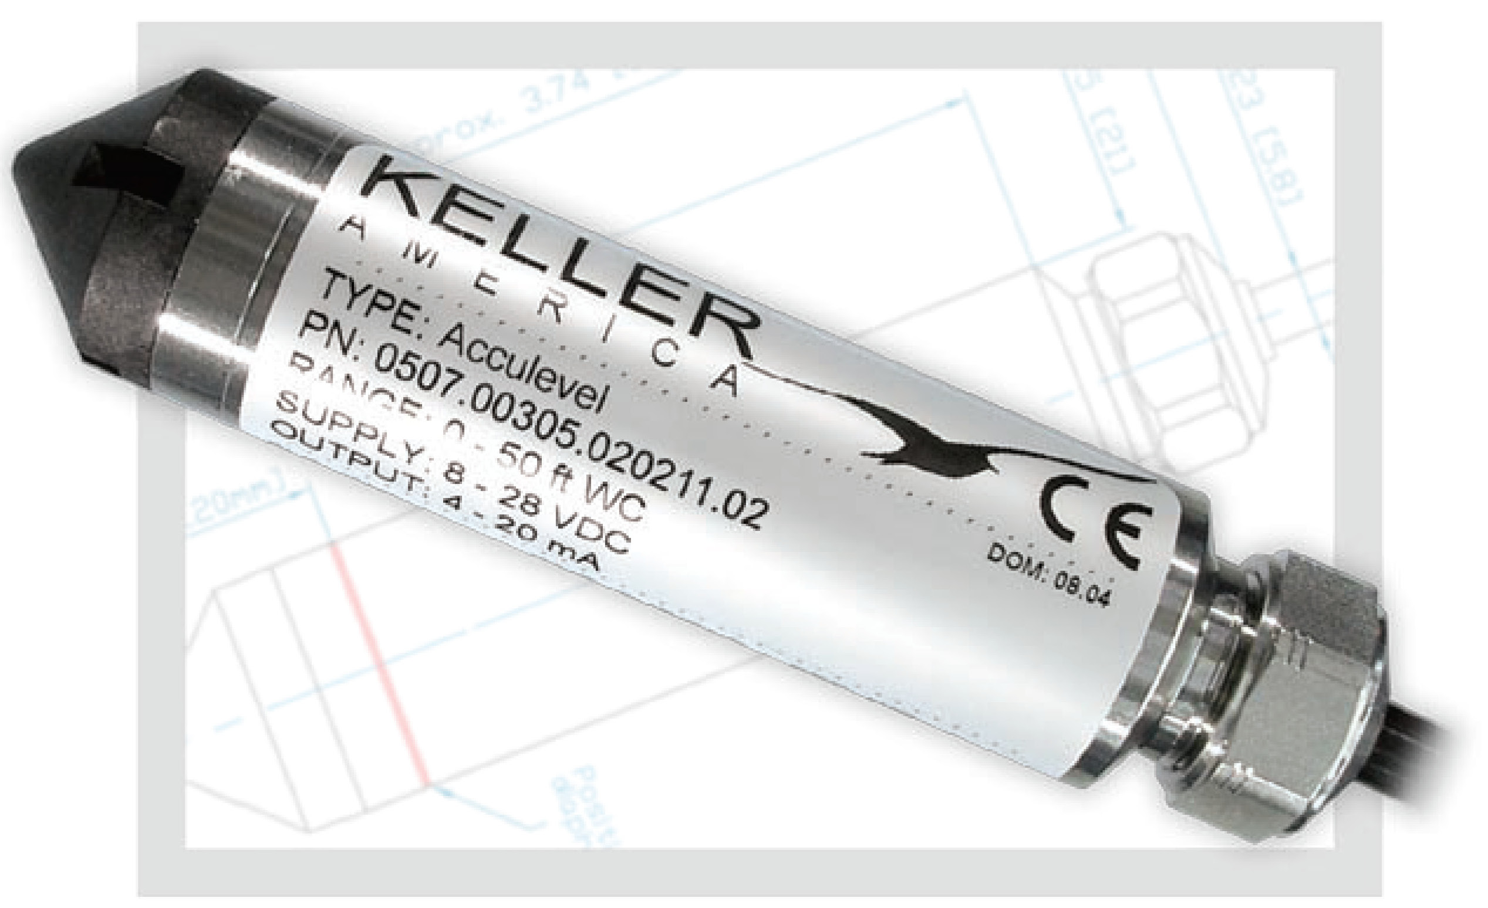
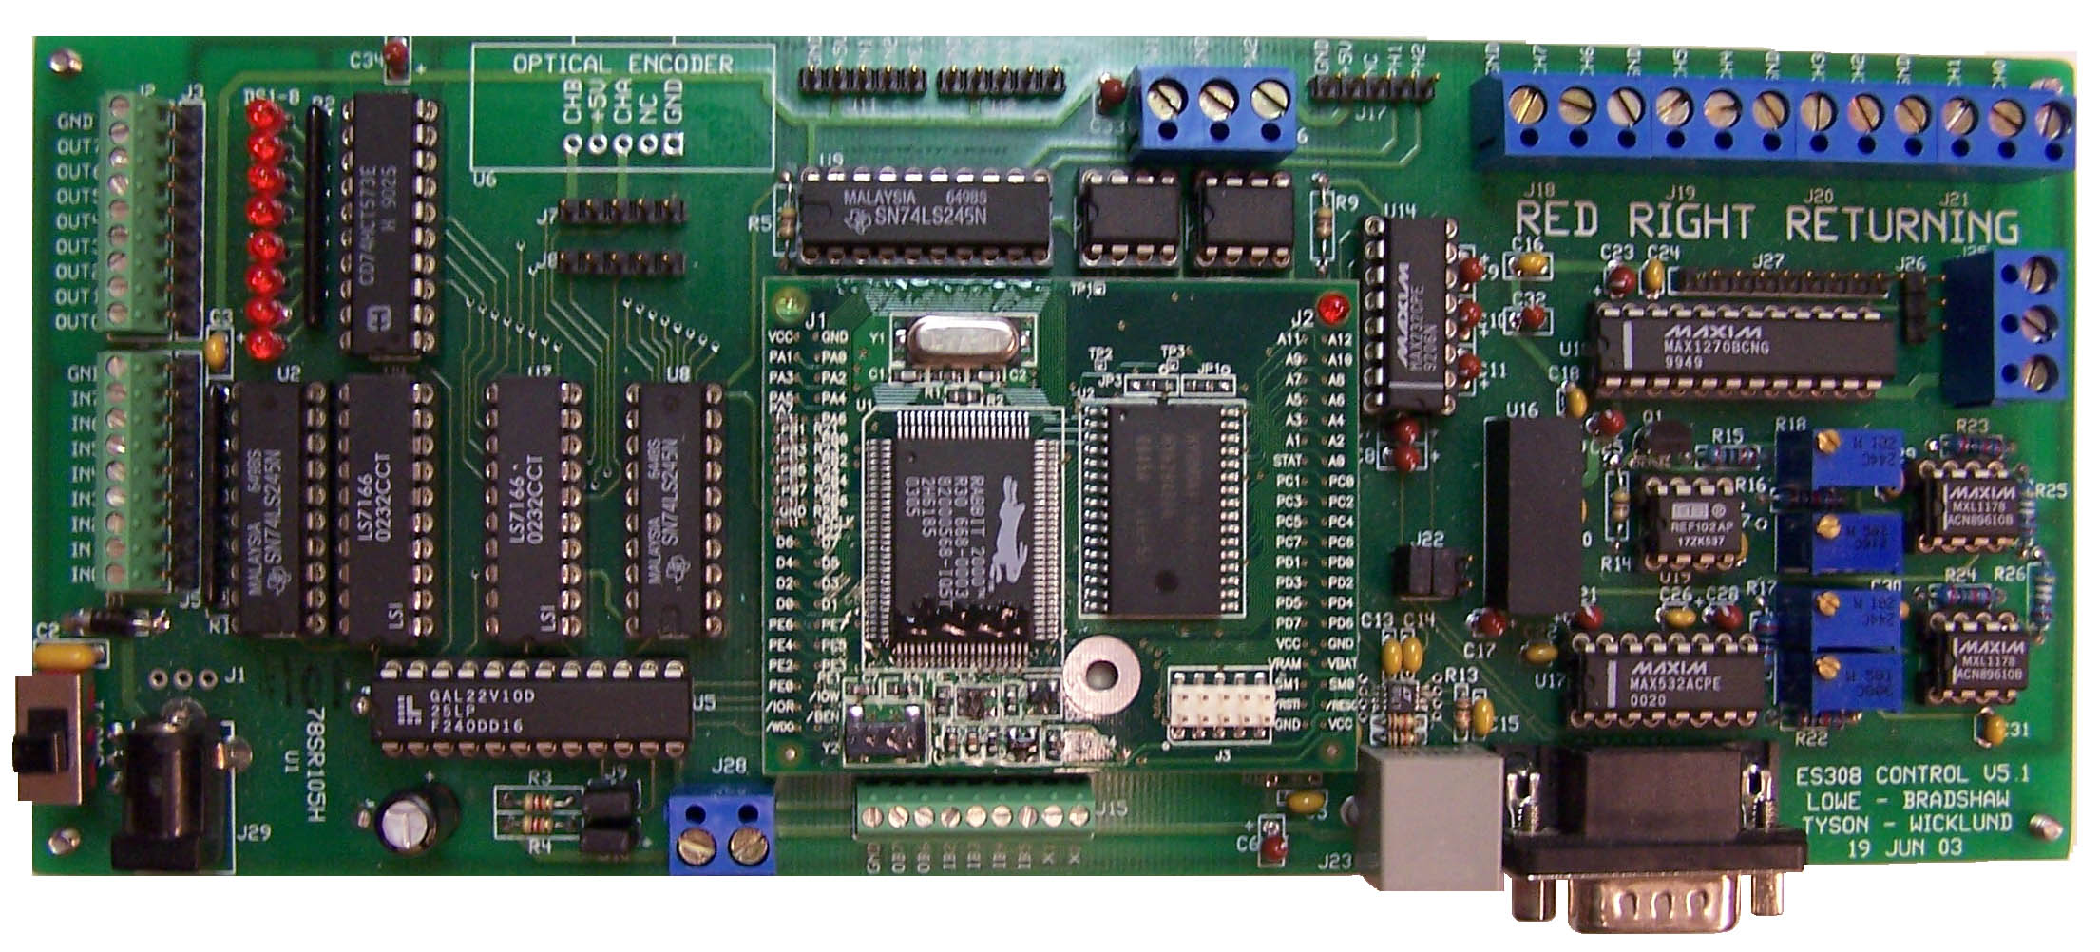
Hardware
3 Keller-America Acculevel Pressure Sensor
ES 308 Board

Slide 12
Software
Dynamic C
To determine when the pressure is high enough for a tsunami
Controls communication to the equipment on the surface
Microsoft Excel / Matlab
Generates plots of Pressure vs. Time

Slide 13
Current Status
.Built circuit
. Soldered extension cables
. Wrote C code
. Modified BNC Cable to talk to Hydro Lab equipment
. Obtained data at 10 different depths to calibrate the 3 sensors

Slide 14
Future Aspirations
Build case to put in the bottom of the tank
Obtain and configure communication equipment
Conduct turbulence tests

Slide 15


Thank you
GROUB MEMBRES :
DANY MANSOUR
1906163
ALI REDA SULAIMAN
1906051

